Slide 1

C++ SOFTWARE TRAINING
DIWAAN CHANDAR C S
STUDENT | FIRST YEAR
DEPARTMENT OF INFORMATION SCIENCE AND ENGINEERING

Slide 2
WELCOME

Slide 3
ABOUT TRAINING
15 days
400 reward points (150 for attendance 250 for assessment)
80% attendance
Timing 8:30 to 9:30 pm

Slide 4
SYLLABUS
Introduction to C++
C++ syntax
Variables, DataTypes and Operators
Conditional Statements
Looping
Arrays
Strings
Functions
Pointers

Slide 5
SYLLABUS
Introduction to OOP’s
Class/Objects
Polymerism
Inheritance
Constructors
Files
Exceptions

Slide 6
What is C++?
C++ is a cross-platform language that can be used to create high-performance applications.
C++ was developed by Bjarne Stroustrup, as an extension to the C language.
C++ gives programmers a high level of control over system resources and memory.
The language was updated 3 major times in 2011, 2014, and 2017 to C++11, C++14, and C++17.
Variable | Increment
i | i++
C | C++

Slide 7
Why Use C++
C++ is one of the world's most popular programming languages.
C++ can be found in today's operating systems, Graphical User Interfaces, and embedded systems.
C++ is an object-oriented programming language which gives a clear structure to programs and allows code to be reused, lowering development costs.
C++ is portable and can be used to develop applications that can be adapted to multiple platforms.
C++ is fun and easy to learn!
Combination of both low-level & high-level language – a Middle-Level Language

Slide 8
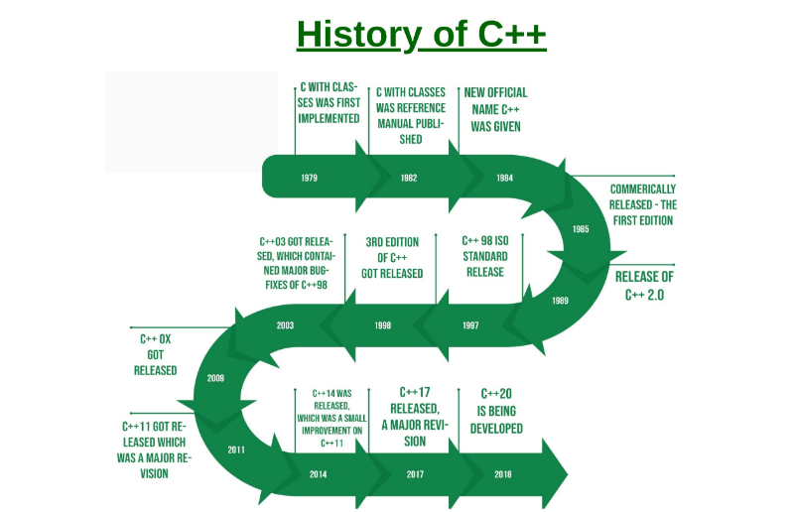
History of C++

Slide 9
Upcoming Version
C++ 20
In development stage
Expected to release in 2020-21

Slide 10
A SAMPLE C++ PROGRAM

Slide 11
THANK YOU
STAY HOME… STAY CODING…

